Slide 1
12.3 Diagonalization

Slide 2
Introduction
In this topic, we will
See that we can write a matrix as a product of an orthogonal matrix, a diagonal matrix and the transpose of the orthogonal matrix
This is described as diagonalization
Look at a few examples
Consider some applications

Slide 3
Diagonalization
Given a symmetric matrix A:R^{n} → R^{n}, then there exists an orthonormal basis of eigenvectors with corresponding eigenvalues λ₁, …, λ_{n}
Thus, for all k = 1, …, n
Define the matrix
This is an orthogonal matrix, for the columns form an orthonormal basis for R^{n}
Recall that isometric matrices on real finite-dimensional vector spaces are called orthogonal matrices
Thus, P^{–1} = P^{T}, and this is the only safe time it is to calculate the inverse

Slide 4
Diagonalization
Now, given a vector u, if we want to find scalars so that
then normally, we must solve
Pα = u
However, because P is orthogonal, we simply have to find
α = P^{–1}u = P^{T}u
Now, if , then

Slide 5
Diagonalization
You will remember the definition of matrix-vector multiplication:
The right-hand side is just the matrix multiplied by the vector
Also, the vector above can be found by multiplying the diagonal matrix of the corresponding eigenvalues

Slide 6
Diagonalization
The consequence of this equation
is that every symmetric matrix can be written as a product of:
An orthogonal matrix of normalized eigenvectors
A diagonal matrix of the corresponding eigenvalues
The transpose of the orthogonal matrix

Slide 7
Symmetry
Note that this product is symmetric:

Slide 8
Diagonalization
In order to create these matrices:
Given a symmetric matrix
Find all the eigenvalues for that matrix
For each eigenvalue, find a linearly independent basis for that eigenspace
That basis will likely not be orthogonal, so apply the Gram-Schmidt algorithm to create an orthonormal basis
This will yield n orthonormal vectors
Define the matrix
Let λ_{k} be the eigenvalue corresponding to the eigenvector and define

Slide 9
Non-symmetric diagonalization
Note that if a matrix has n linearly independent eigenvectors but is not symmetric, then the matrix P will not be orthogonal
Thus, calculating the inverse will necessarily require you to
Apply a numerically unstable algorithm to calculate the inverse, so that Au = PDP^{–1}u
Use Gaussian elimination and backward substitution, or some other matrix decomposition to solve Pα = u
Having found α, calculate PDα
Because the eigenvectors are not orthogonal, you cannot rely that each will individually express the effect in the direction of that eigenvector

Slide 10
Example
Find the diagonal decomposition of:

Slide 11
Example
Find the diagonal decomposition of:

Slide 12
Example
Find the diagonal decomposition of:

Slide 13
Example
Thus, we have that for

Slide 14
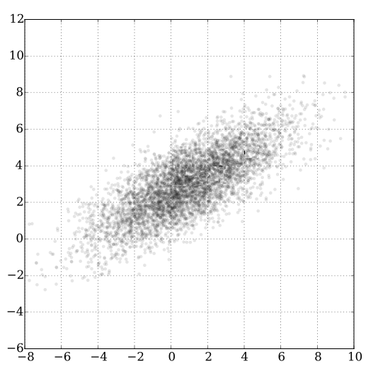
Applications
Consider this data:
There appears to be a relationship between the variables
Principal component analysis allows you to find this by:
Calculating the covariance matrix
Finding the normalized eigenvectors
Multiplying each eigenvector by its corresponding eigenvalue
Transposing them to the center of mass
Wikipedia user: Nicoguaro

Slide 15
Applications
Consider a mass that has multiple stresses placed up on it
The principal directions of the stress can be found by finding the eigenvalues and eigenvectors of the stress tensor
Often the stress can be modeled on only the largest of these eigenvalues
Wikipedia user: Nevit Dilmen

Slide 16
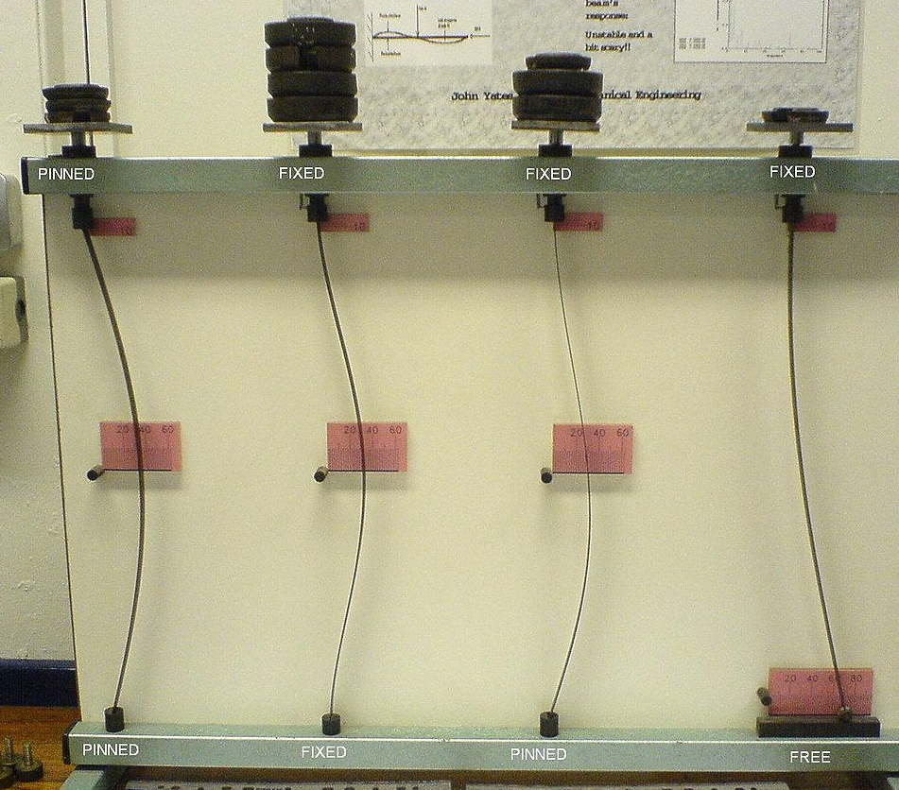
Applications
Given a load-bearing structure
When the structure is placed under a load, the structure not only bears the load, but also buckles under that load, thus changing its shape
The relative effect of the buckling is representable by a symmetric tri-diagonal matrix:
Each point affects the points nearest it, and the effect on one point equals the effect on the other
Wikipedia user: Grahams Child

Slide 17
Summary
Following this topic, you now
Know that a symmetric matrix can be written as PDP^{T}
Understand this allows you to focus on effect of the matrix
Have seen two examples
Looked at a few applications

Slide 18
References
[1] https://en.wikipedia.org/wiki/Diagonalizable_matrix#Diagonalization

Slide 19
Acknowledgments
None so far.

Slide 20
Colophon
These slides were prepared using the Cambria typeface. Mathematical equations use Times New Roman, and source code is presented using Consolas. Mathematical equations are prepared in MathType by Design Science, Inc.
Examples may be formulated and checked using Maple by Maplesoft, Inc.
The photographs of flowers and a monarch butter appearing on the title slide and accenting the top of each other slide were taken at the Royal Botanical Gardens in October of 2017 by Douglas Wilhelm Harder. Please see
https://www.rbg.ca/
for more information.

Slide 21
Disclaimer
These slides are provided for the ne 112 Linear algebra for nanotechnology engineering course taught at the University of Waterloo. The material in it reflects the authors’ best judgment in light of the information available to them at the time of preparation. Any reliance on these course slides by any party for any other purpose are the responsibility of such parties. The authors accept no responsibility for damages, if any, suffered by any party as a result of decisions made or actions based on these course slides for any other purpose than that for which it was intended.

